Slide 1
SOFT COMPUTING
INTRODUCTION - ANNs & THEIR APPLICATIONS

Slide 2
Hard Vs Soft Computing Paradigms
Hard computing
Based on the concept of precise modeling
Works well for simple problems
Soft Computing is the use of inexact solutions to computationally hard tasks using approximation, heuristic methods

Slide 3
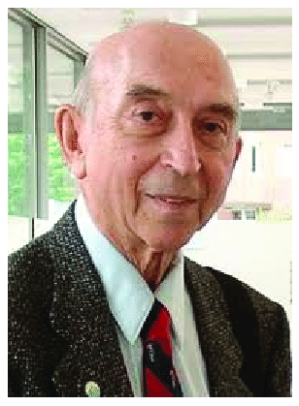
Unlike Hard computing , Guiding principle of SC is to exploit the tolerance for imprecision, uncertainty, and partial truth to achieve tractability, robustness, low solution cost, better rapport with reality.
Dr. Zadeh :
Soft Computing is well suited for real world problems where ideal models are not available.

Slide 4
ARTIFICIAL NEURAL NETWORKS
ANNs : “mathematical models inspired from our understanding of human brain”
ANN : A computer program designed to recognize patterns and learn “like” human brain

Slide 5
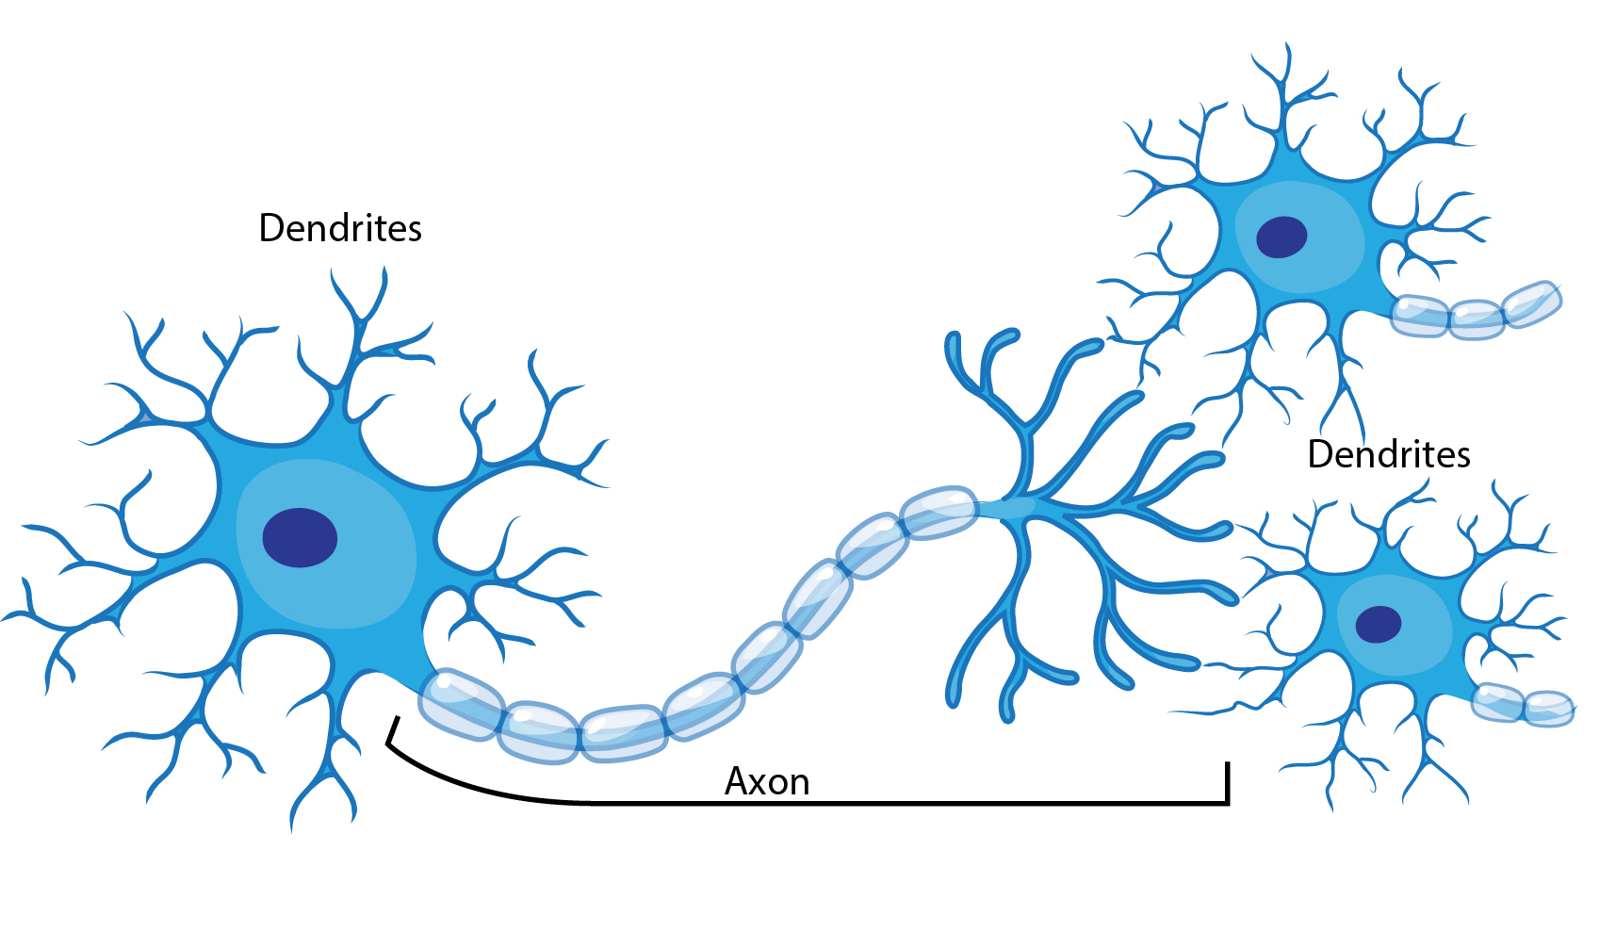
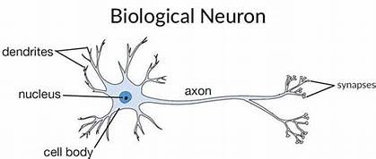

Slide 6
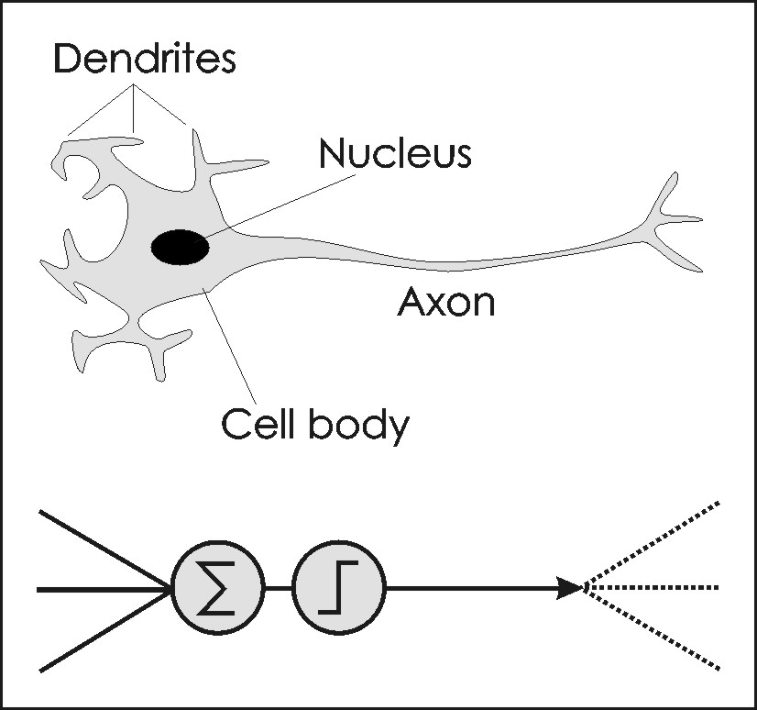
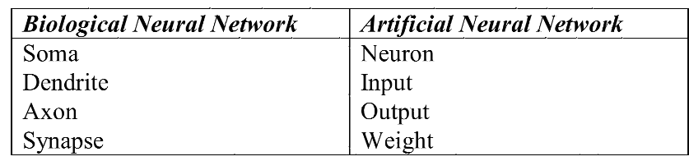

Slide 7
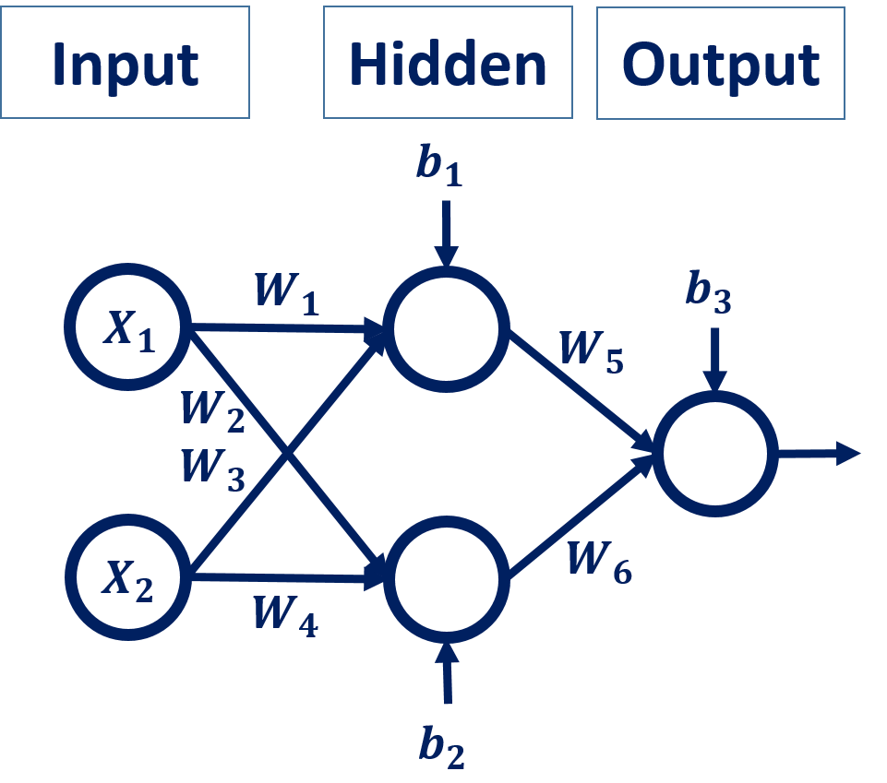

Slide 8
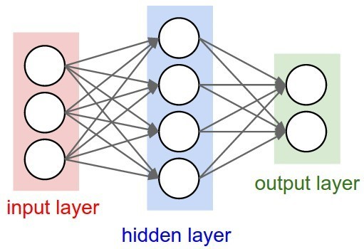
A neural network is a system composed of many neurons also called processing elements(PEs) operating in parallel whose function is determined by
Network Structure,
Connection Strengths
The Processing performed at computing elements or nodes.
Number of neurons in input and output layer depends on the training set

Slide 9
PRINCIPAL ELEMENTS REQUIRED TO SPECIFY ANNs
Topology - layers and interconnections
Learning/Adaptation - how network is configured to store information
Recall - How stored information is retrieved

Slide 10
CLASSIFICATION OF LEARNING
Supervised learning
Unsupervised learning
Reinforcement learning

Slide 11
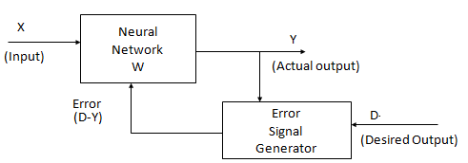
Supervised Learning
Training pair = [input vector, target vector]
Error changes Model parameters [?]

Slide 12
Unsupervised learning

Slide 13
Unsupervised learning
Training samples contain only input patterns
No desired output is given (teacher-less)
Learn to form classes/clusters of sample patterns according to similarities among them with
No prior knowledge as what features are important for classification, and how many classes are there.

Slide 14
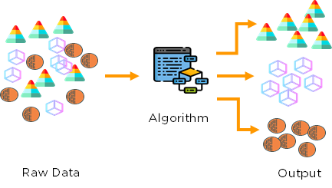

Slide 15
Reinforcement Learning:
This strategy is built on observation.
The ANN makes a decision by observing its environment.
The machines are exposed to the environment where they can learn autonomously by hit and trial /experiential method.

Slide 16
Example of RL : learning motor skills like riding a bike.
You try and see what makes you fall over and what keeps you upright
An agent interacting with the world makes observations, takes action, and is rewarded or punished.
it should learn to choose actions in such a way as to obtain lot of rewards

Slide 17
Application Fields of ANNs
ANNs are used in a variety of domains like Medical, Forecasting, Industrial measurement and Control, Image processing, Finance & Banking ,Voice recogniton/synthesis, Targeted marketing, Intelligent searching etc
Applications can be classified into following categories:

Slide 18
Function approximation:
Neural nets are highly capable of approximating almost any function in arbitrary dimensionality.
Given input/output pairs
(x₁,d₁),(x₂ ,d₂ ), ....(x_{n} ,d_{n} ),
approximate the function g(.) such that
d =g(x)

Slide 19
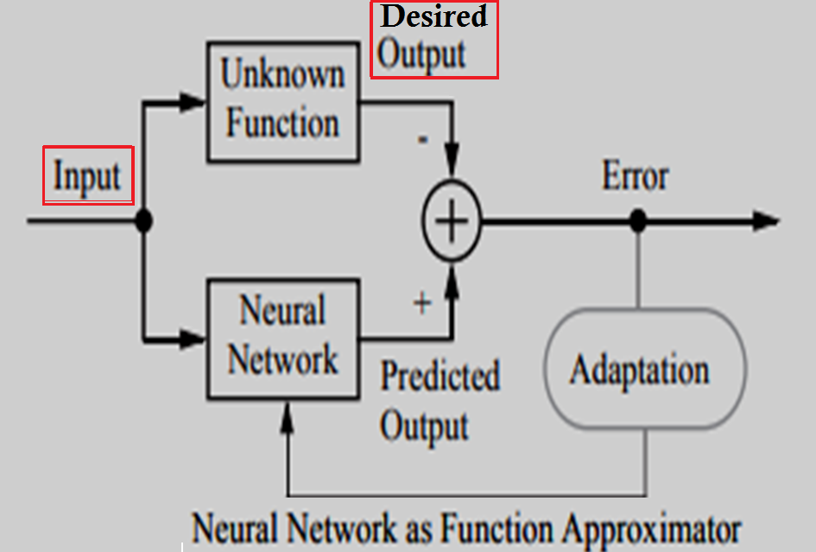

Slide 20
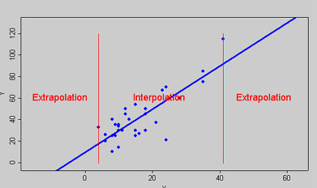

Slide 21
Outliers
An outlier is an observation that appears to deviate markedly from other observations in the sample.
Identification of potential outliers is important
An outlier may indicate bad data.
the data may have been coded incorrectly or an experiment may not have been run correctly.

Slide 22
If it can be determined that an outlying point is in fact erroneous, then the outlying value should be deleted from the analysis (or corrected if possible).
In some cases, it may not be possible to determine if an outlying point is bad data.
Outliers may be due to random variation or may indicate something scientifically interesting.
In any event, do not simply delete the outlying observation.

Slide 23

Black Swan Event is an incident that occurs randomly and unexpectedly
if you saw a thousand swans and they were all white, you might logically conclude that all swans are white.
The flaw in logic is that even when the premises are true, the conclusion can still be false.
In other words, just because you did not see a black swan, it does not mean they do not exist
Dutch explorers discovered in 1697, black swans are simply outliers -- rare birds

Slide 24
Classification is about predicting a label
and
Regression is about predicting a quantity.

Slide 25
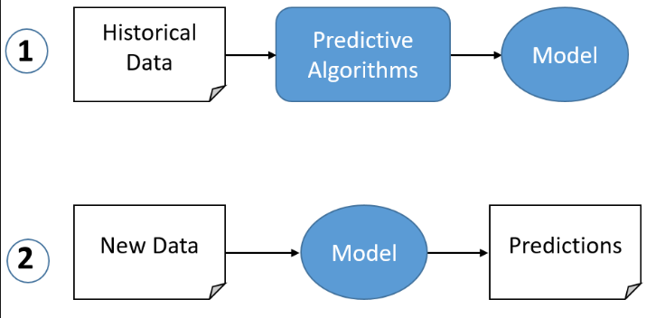

Slide 26
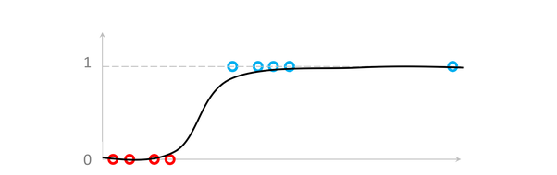
The logistic function is a Sigmoid function, which takes any real value between zero and one.

Slide 27
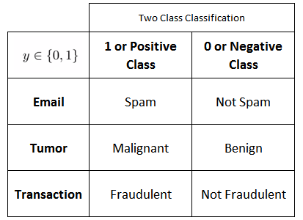
Two types of classication problems:
binary classication where there are only two classes, and
multi-class classication where the number of
classes is higher than two

Slide 28
A classification task with more than two classes;
e.g., classify a set of images of fruits which may be oranges, apples, or pears.
Multi-class classification makes the assumption that each sample is assigned to one and only one label: a fruit can be either an apple or a pear but not both at the same time.

Slide 29
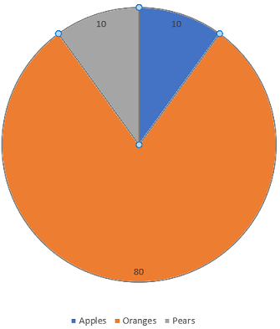
ANY COMMENTS ?

Slide 30
A balanced dataset is the one that contains equal or almost equal number of samples from the positive and negative class.
If the samples from one of the classes outnumbers the other the data is skewed in favour of one of the class.
This may cause problems in training, because the majority class can dominate the minority class and the classifier may only learn one concept instead of two distinct concepts.

Slide 31
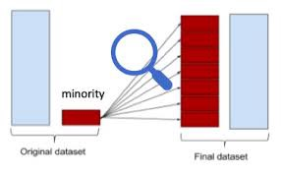
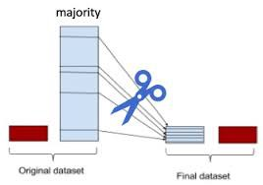
Oversampling
Undersampling

Slide 32
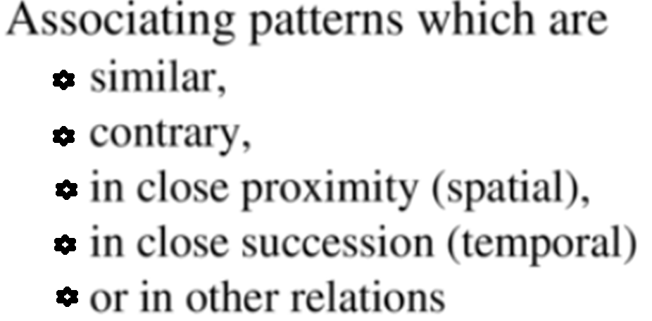
ASSOCIATION:
It is the task of associating/mapping input patterns to target patterns (attractors)

Slide 33
Autoassociation :
the input training vector and the output target vectors are the same.
Autoassociative neural networks are feedforward nets trained to produce an approximation of the identity mapping between network inputs and outputs.
Later, a partial or distorted /noisy version of the pattern is presented and the task is to retrieve that [ Noise Removal].

Slide 34
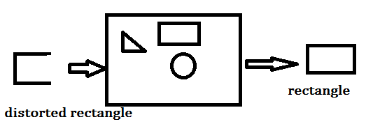
Storing information is called ENCODING
A network stores data as a result of LEARNING
A degraded input pattern serves as a CUE for retrieval of its original

Slide 35
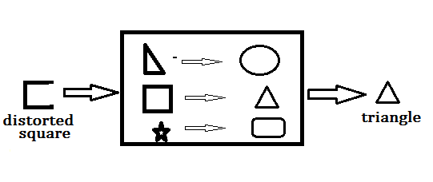
HETROASSOCIATION : input training vector and the output target vectors are not the same.
Set of input patterns are associated with set of output patterns
Examples:
Encryption for cyber security
Translation from one language to other

Slide 36
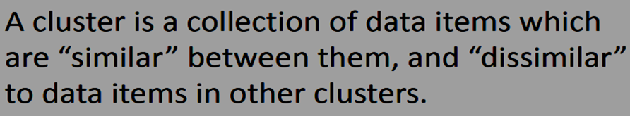
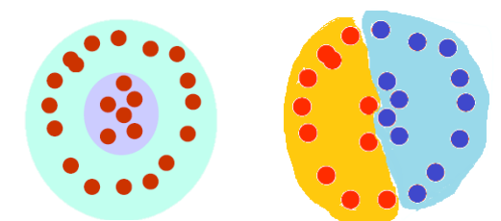
CLUSTERING
Clustering can be said as identification of similar classes of objects.

Slide 37
PERFORMACE MEASURE OF
CLASSIFICATION/CLASSIFIER
Assume we have two classes, i.e., binary classication,
Classification model produces continuous or discrete outputs.
Discrete output that is generated from a classification model represents the predicted discrete class label of the unknown/test sample, while
Continuous output represents the estimation of the sample's class membership probability

Slide 38
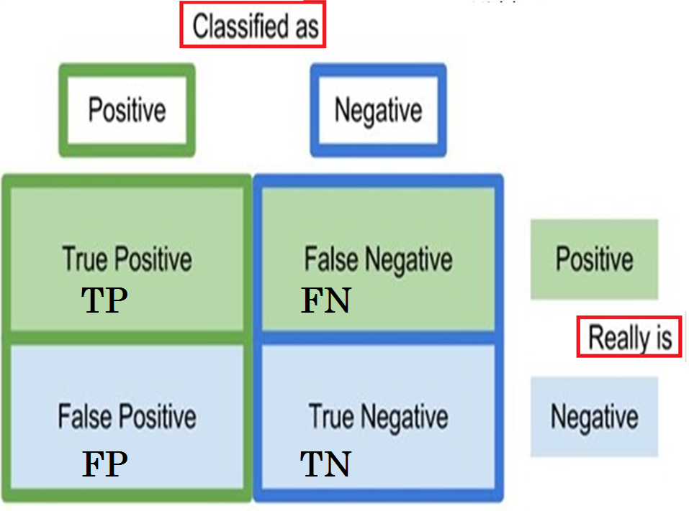
CONFUSION MATRIX of
Two Class Classification problem
CONFUSION MATRIX

Slide 39
Performance measurement TERMS in classification

Slide 40
Assessing the Accuracy
of
Classifications
of
Remotely Sensed Data

Slide 41
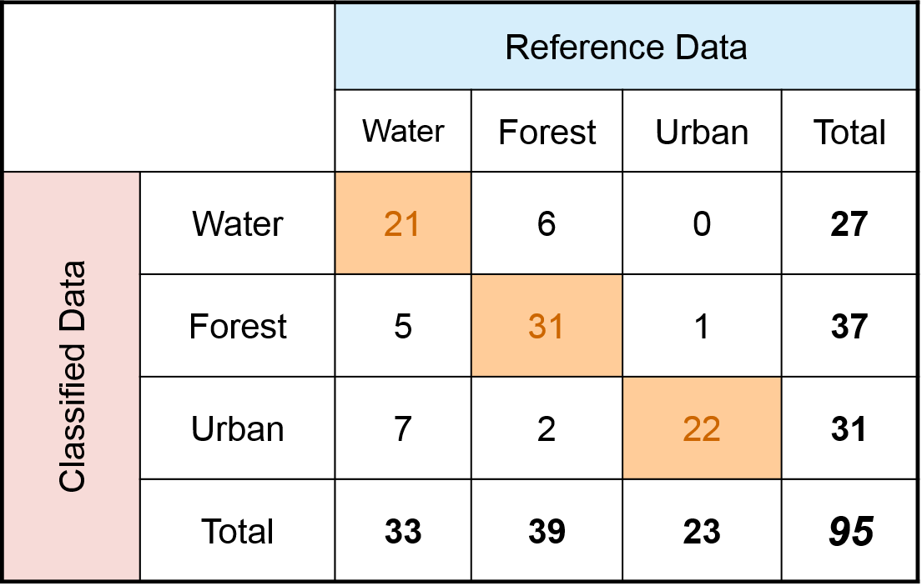
EXAMPLE

Slide 42
Overall Accuracy : out of all of the reference sites what proportion were mapped correctly.
[in binary classification num is TP+TN, in multiclass it is sum of TPs]

Slide 43
Number of correctly classified site:
21 + 31+ 22 = 74
Total number of reference sites = 95
Overall Accuracy = 74/95 = 77.9%

Slide 44
Errors of Commission
Refers to classified sites for incorrect classifications in the classified data.
ERROR OF COMMISSION
Errors of Omission
Refers to reference sites that were left out (or omitted) from the correct class in the reference data.
ERROR OF OMMISSION

Slide 45
FIND COMMISSION ERRORS

Slide 46
Error of Commission for Water
Water: Incorrectly classified sites: 6 + 0 = 6
Total classified sites for water = 27
Commission Error = 6/27 = 22%

Slide 47
Error of Commission for Forest, Urban
Forest: Incorrectly classified sites: 5 + 1 = 6
Total classified sites for forest = 37
Commission Error = 6/37 = 16%
Urban: Incorrectly classified sites: 7 + 2 = 9
Total classified sites for Urban = 31
Commission Error = 9/31 = 29%

Slide 48
FIND OMMISSION ERRORS
Refers to reference sites that were left out (or omitted) from the correct class in the reference set

Slide 49
Calculate Error of Ommission for Water, Forest, Urban
Water: Incorrectly omitted from reference sites: 5 + 7 = 12
Total # of reference sites = 33 Omission Error = 12/33 = 36%
Forest: Error of Omission from reference sites: 6 + 2 = 8
Total # of reference sites = 39 Omission Error = 8/39 = 20%
Urban: Error of Omission from reference sites: 0 + 1 = 1
Total # of reference sites = 23 Omission Error = 1/23 = 4%

Slide 50
Producer’s Accuracy:
Accuracy from the point of view of the map maker (the producer)
It is the number of reference sites classified correctly divided by the total number of reference sites for that class.
Producer's Accuracy = 100% - Omission Error

Slide 51
FIND PRODUCER ACCURACY
Water:Correctly classified reference sites = 21
Total reference sites = 33
Producer’s Accuracy = 21/33 = 64%
= 1-ommission error = 100- 36

Slide 52
Forest: Correctly classified reference sites = 31
Total reference sites = 39
Producer’s Accuracy = 31/39 = 80% = 100 - 20
Urban: Correctly classified reference sites = 22
Total reference sites = 23
Producer’s Accuracy = 22/23 =96% =100 - 4

Slide 53
User’s /Consumer’s Accuracy: Accuracy from the point of view of a map user, not the map maker.
Calculated by taking the total number of correct classifications for a particular class and dividing it by the total classified.
This is referred to as reliability.
User's Accuracy =
100% - Commission Error.

Slide 54
Find User’s Accuracy

Slide 55
User's Accuracy for Water Water:
Correctly classified sites = 21
Total classified sites = 27
User's Accuracy = 21/27 = 78%
=1- commission error = 100- 22

Slide 56
Forest: Incorrectly classified sites = 31
Total classified sites = 37
User's Accuracy = 31/37 = 84% =1- commission error = 100-16
Urban: Incorrectly classified sites = 22
Total classified sites = 31
User's Accuracy = 22/31 = 71 =1- commission error = 100 - 29

Slide 57
Comparing User's and Producer's Accuracy
Producer’s accuracy for the Urban class was 96% while the user's accuracy was 71%.
This means that even though 96% of the reference urban areas have been correctly identified as “urban”,
only 71% percent of the areas identified as “urban” [22 out of 31] in the classification were actually urban. Water (=7) and forest (=2) areas were mistakenly classified as urban.

Slide 58
Biometrics for surveillance/security for identifying authorized persons
If an Authorized person is recognized correctly, it counts to the number of
True Positives (TP)
if a test image of an Authorized person is rejected and labeled as impostor due to classifier's limited ability to recognize correctly, the count adds to the number of
False Negatives (FN).

Slide 59
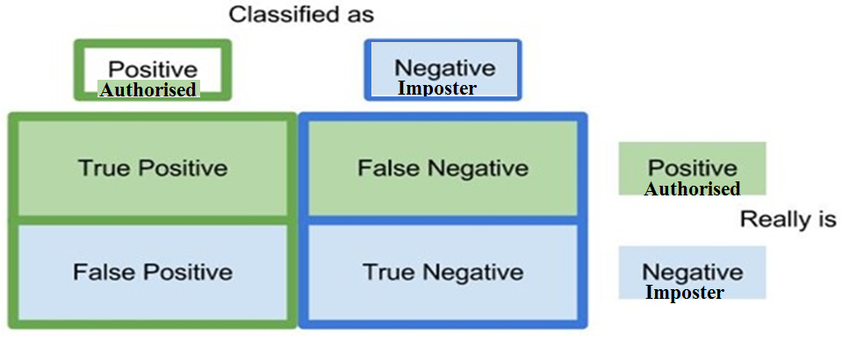

Slide 60
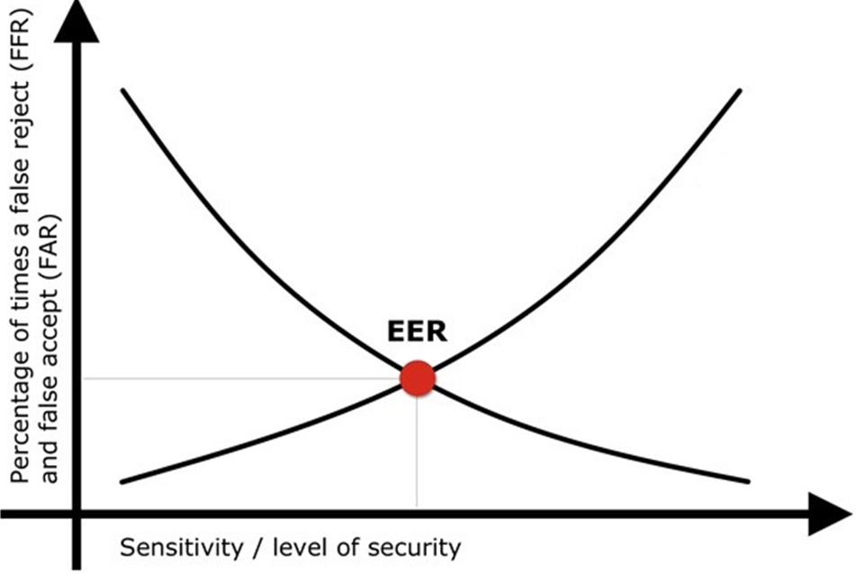
LABEL FAR & FRR
FAR
FRR
Equal Error Rate

Slide 61


Slide 62
PRIOR BELIEFS
+DATA
=
REVISED BELIEFS
AIQ by NICK POLSON and JAMES SCOTT

